Slide 1
19CSE305: MACHINE LEARNING

Slide 2
Support Vector Machines(SVM)
Reference:
Machine Learning-Saikat Dutt, Coursera-Andrew ng, Statquest

Slide 3
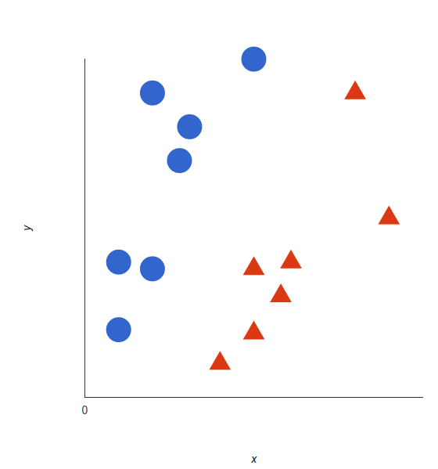
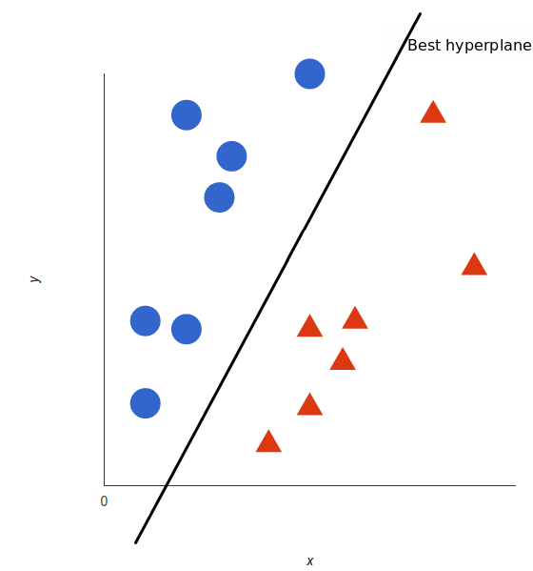
Support Vector Machine (SVM)
Support Vector Machine (SVM) is a supervised machine learning algorithm
Classification , Regression
In the SVM algorithm, we plot each data item as a point in n-dimensional space.
n- Number of features
Classification: by finding the hyper-plane (decision boundary) that differentiates the two classes very well.

Slide 4
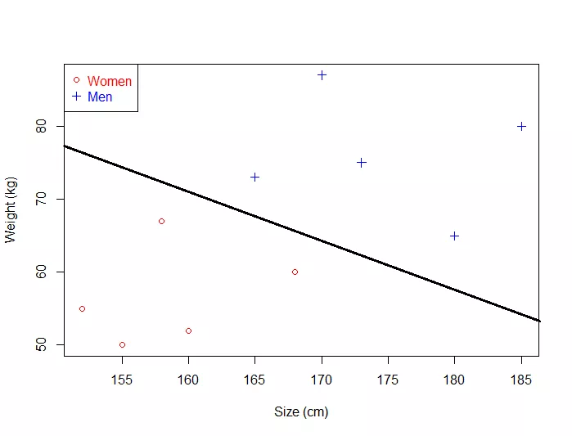
Contd…
SVM learns a linear model
Linear Model: It is a line (in complicated words it is a hyperplane). If your data is very simple and only has two dimensions, then the SVM will learn a line which will be able to separate the data.
The SVM is able to find a line which separates the data

Slide 5
If it is just a line, why do we talk about a linear model?
Because you cannot learn a line.
So instead of that:
Suppose that the data we want to classify can be separated by a line
The line can be represented by the equation y=wx+b (this is our model)
There is an infinity of possible lines obtained by changing the value of w and b
To determine which are the values of w and b giving the "best" line separating the data.

Slide 6
Support Vector Machine (SVM)
denotes +1
denotes -1
How would you classify this data?

Slide 7
Support Vector Machine (SVM)
denotes +1
denotes -1
How would you classify this data?

Slide 8
Support Vector Machine (SVM)
denotes +1
denotes -1
How would you classify this data?

Slide 9
Support Vector Machine (SVM)
denotes +1
denotes -1
How would you classify this data?

Slide 10
Support Vector Machine (SVM)
denotes +1
denotes -1
Any of these would be fine..
..but which is best?
Select the hyperplane with maximum MARGIN

Slide 11
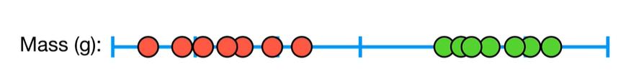
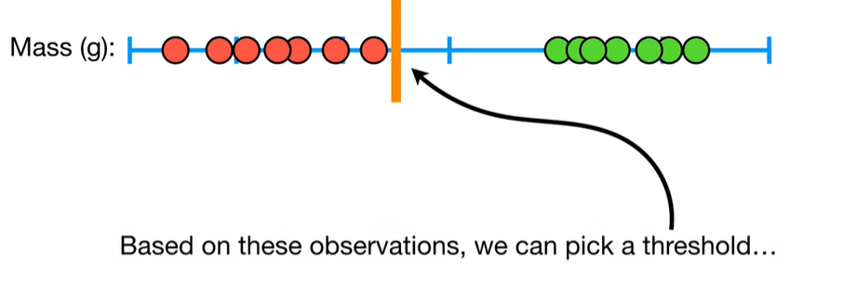
Maximal margin classifier
Obese
Not Obese

Slide 12
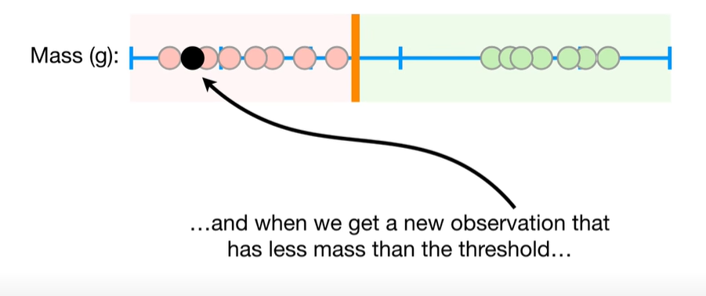
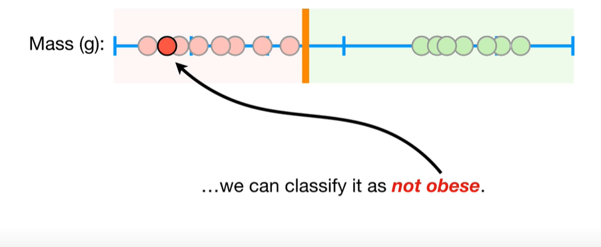
Maximal margin classifier
New observation with less mass than the threshold

Slide 13
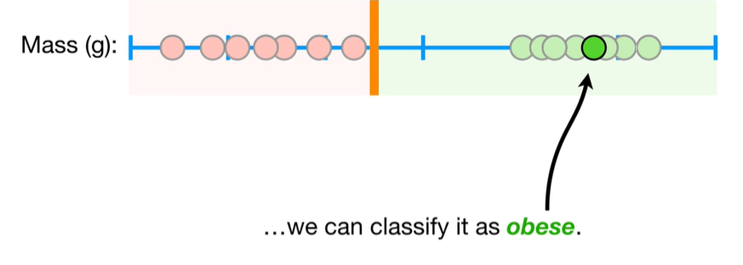
Maximal margin classifier
New observation with more mass than the threshold

Slide 14
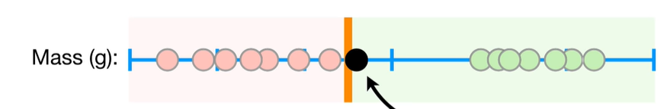
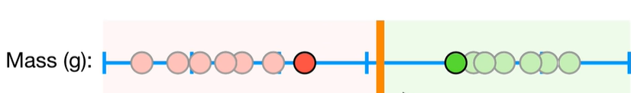
Threshold not good
New threshold: Midpoint

Slide 15
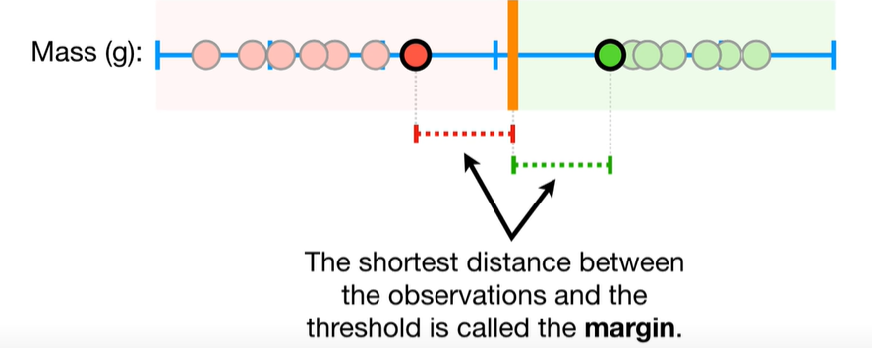
Maximal margin classifier

Slide 16
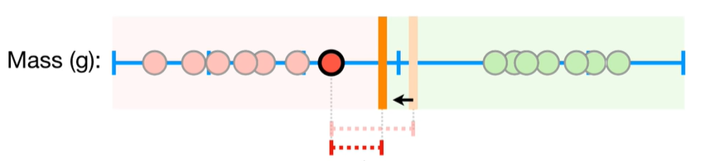
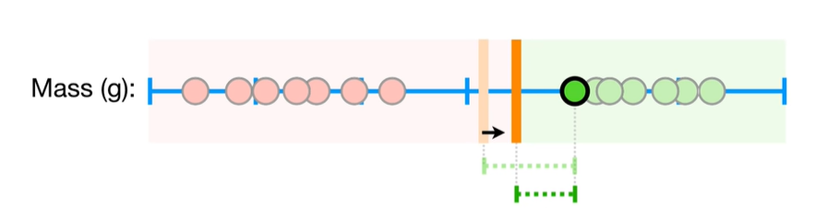
Support Vector Classifier
Maximal margin classifier: When we use threshold that gives maximum margin
for classification
Very sensitive to outliers in the training dataset
Solution: Allow Miss classifications
Soft Margin
Classifier
Support Vector Classifier

Slide 17
Soft Margin
Soft Margin : When allow misclassifications, the distance between the training data and the threshold is called Soft Margin.
When soft margin is used as a threshold for the classification, then it is known as “Soft margin classifier” or “Support vector classifier” .

Slide 18
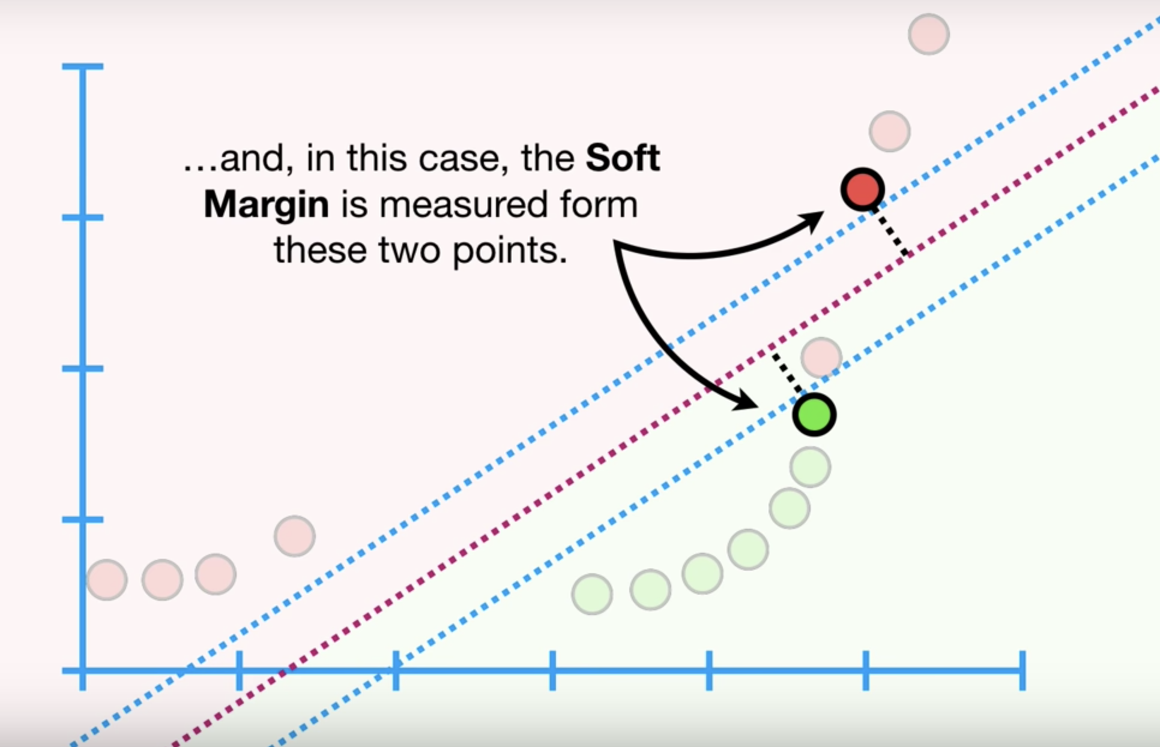
Soft Margin

Slide 19
Support Vectors
Support Vector: Observations on the edge and within the soft margin
When the observations/data are 1-Dimensional , the support vector classifier is a single point on a 1-dimensional number line.

Slide 20
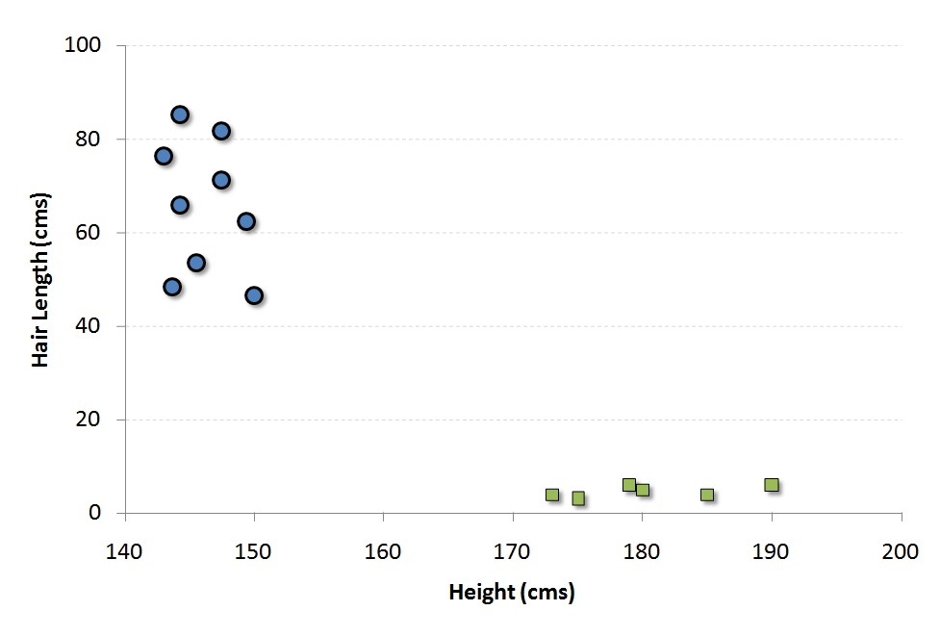
Support Vector Classifier
Soft margin
When the observations/data are 2-Dimensional , the support vector classifier is a line on a 2-dimensional space.
When the observations/data are 3-Dimensional , the support vector classifier is a plane on a 3-dimensional space.

Slide 21
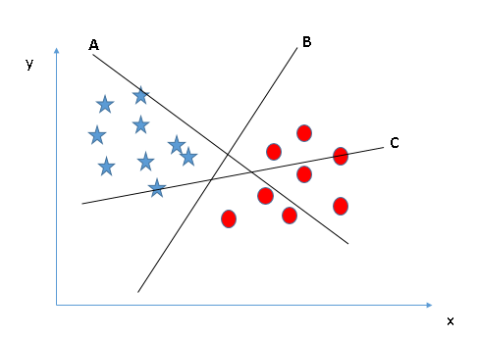
How to select the best hyperplane?
Scenario-1
Select the hyper-plane which segregates the two classes better

Slide 22
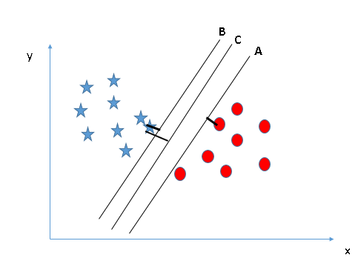
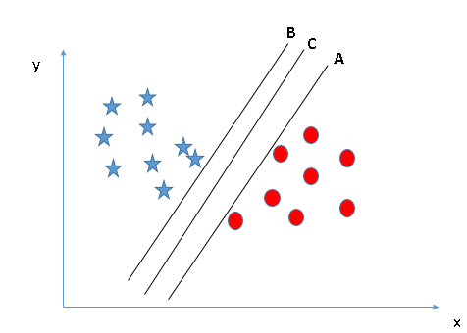
How to select the best hyperplane?
Scenario-2
Select the hyper-plane with maximum margin

Slide 23
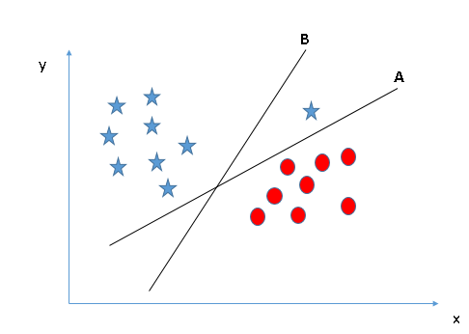
How to select the best hyperplane?
Scenario-3
Selects the hyper-plane which classifies the classes accurately prior to maximizing margin.

Slide 24
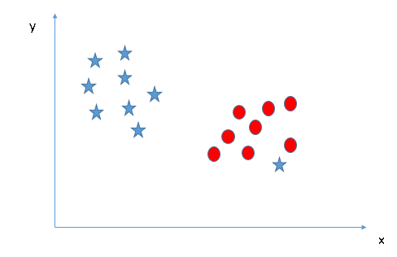
How to select the best hyperplane?
Scenario-4
Ignore outliers and find the hyper-plane that has the maximum margin

Slide 25
How to select the best hyperplane?
The hyperplane should segregate the data instance belonging to the 2 classes in the best possible way.
It should maximize the distance between the nearest data points of both the classes, i.e. Maximize the margin
If there is a need to prioritize between higher margin and lesser misclassification, the hyperplane should try to reduce misclassification.

Slide 26
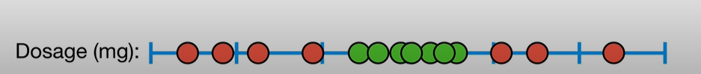
Support Vector Machines
0.5 0.7 0.9 2
0.5 0.7 0.9 2
0.5 0.7 0.9 2
Maximal margin classifier and Support Vector Classifiers will not work

Slide 27
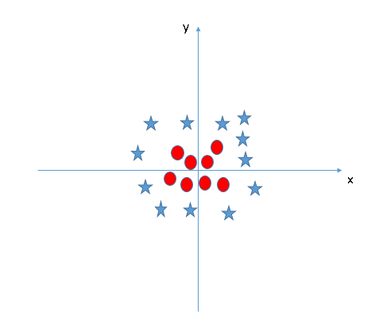
Support Vector Machines
Not linearly separable
SVM uses KERNAL TRICK
Assumption: Data which is not linearly separable in an N-Dimensional space may be linearly separable a higher dimensional space

Slide 28
Support Vector Machines
X
0.5
6
0.7
0.8
0.9
2
2.3
2.4
2.5
5
6
7
8
0.5 0.6 0.7 0.8 0.9 2 2.3 2.4 2.5 5 6 7 8

Slide 29
Support Vector Machines
X | X^2
0.5 | 0.25
0.6 | 0.36
0.7 | 0.49
0.8 | 0.64
0.9 | 0.81
2 | 4
2.3 | 5.29
2.4 | 5.76
2.5 | 6.25
5 | 25
6 | 36
7 | 49
8 | 64
How do we decide the data transformations to higher dimensions??
SVM uses kernel functions to systematically find support vector classifiers in higher dimensions.

Slide 30
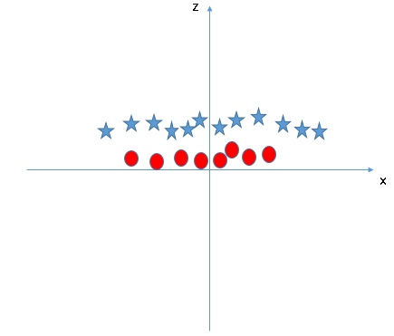

Support Vector Machines
z=x^2+y^2

Slide 31
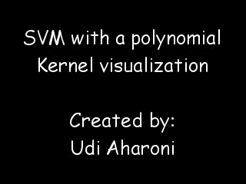

Slide 32
SVM-Kernel
The SVM kernel is a function that takes low dimensional input space and transforms it to a higher dimensional space
i.e. it converts not separable problem to separable problem.
Linear Kernel
Polynomial Kernel
RBF Kernel/ Radial Kernel

Slide 33
SVM-Kernel
Linear Kernel:
Commonly recommended for text classification because most of these types of classification problems are linearly separable.
Linear kernel works really well when there are a lot of features.
Linear kernel functions are faster than most of the others and have fewer parameters to optimize
Defines the decision boundary that the SVM returns.
W is the weight vector that you want to minimize, X is the data that you're trying to classify, and b is the linear coefficient estimated from the training data.

Slide 34
SVM-Kernel
Polynomial Kernel:
The polynomial kernel isn't used in practice very often because it isn't as computationally efficient as other kernels and its predictions aren't as accurate.
f(X1, X2) represents the polynomial decision boundary that will separate your data. X1 and X2 represent your data.

Slide 35
SVM-Kernel
Gaussian Radial Basis Function (RBF):
One of the most powerful and commonly used kernels in SVMs. Usually the choice for non-linear data.

Slide 36
SVM-Kernel
Sigmoid:
More useful in neural networks than in support vector machines
In this function, alpha is a weight vector and C is an offset value to account for some miss-classification of data that can happen.

Slide 37
THANK YOU

